Slide 1

ADIDAS US SALES ANALYSIS
Presented By:
Angel Jacob
Data Analytics ,2025

Slide 2
“Every stripe tells a story—of effort, ambition, and the courage to keep going.” — Adidas-inspired motivational line

Slide 3
Abstract
Adidas is a global leader in the sportswear industry, known for its innovation and quality. Founded in 1949 in Germany by Adolf Dassler
The company has grown into one of the most recognized names in athletic apparel, footwear, and accessories.

Slide 4
Introduction
Adidas is one of the leading manufactures for footwear ,apparel and accessories ,utilize continuous sales data analysis to uncover market trends and enhance future sales.

Slide 5
Objectives
To identify the best retailers.
To analyse sales trends in different regions.
To determine sales method preferred by customers.
To analyse state wise sales.

Slide 6
Dataset
Source of dataset : Kaggle
Number of columns : 14
Number of rows : 9649
Time period : 2020 - 2021

Slide 7
Visualization
Key visuals
Cards : which includes total sales, unit sold, profit, profit margin.
3-D pie chart :To analyse total sales by region.
Bar chart : To analyse total profit by product in gender wise.
Donut chart :To shows the total sales by sales method.
Column chart : To understand total sales by retailer.
Stacked bar chart :to find total sales by top 10 states.
Slicers :add 4 slicers; year, region, retailers and sales method.

Slide 8
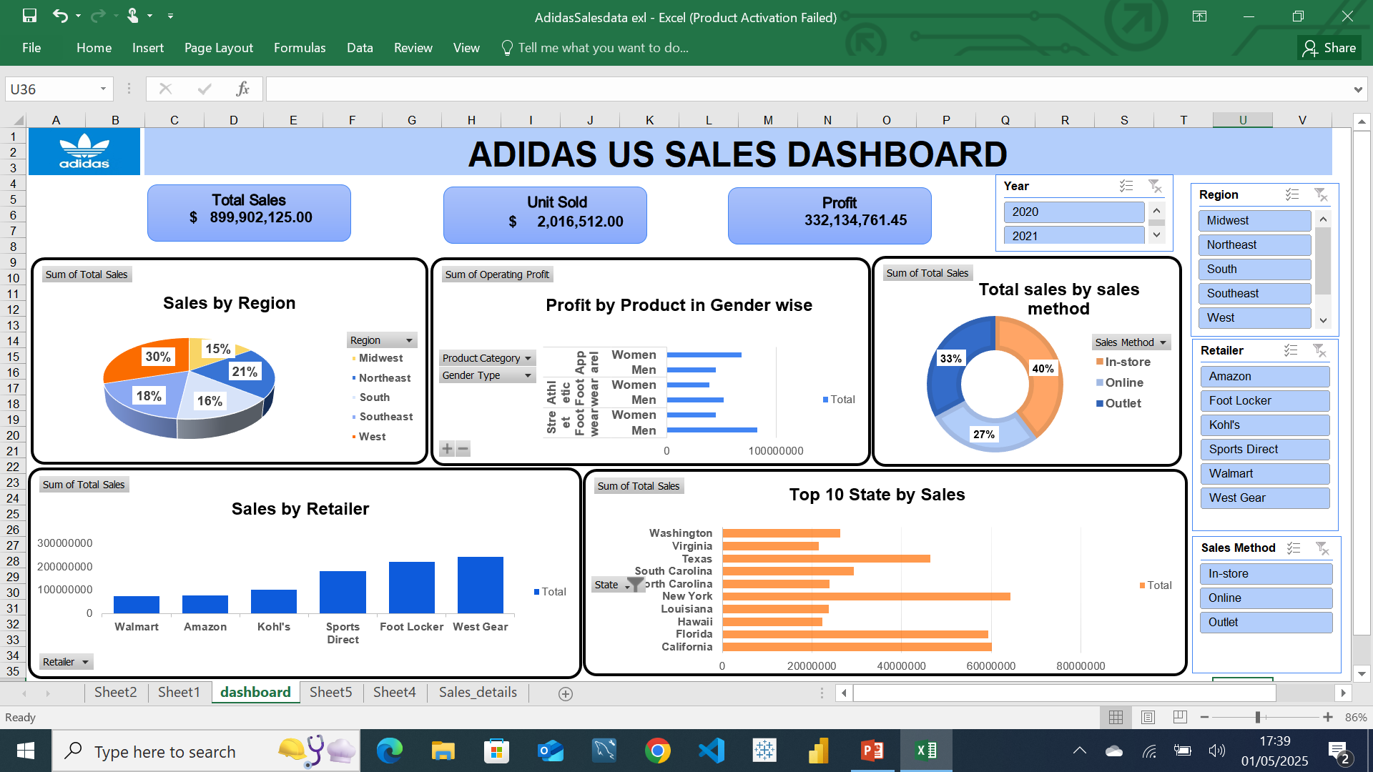

Slide 9
Insights
The retailers, West Gear and Walmart have highest and lowest number of sales respectively.
The west region has produced the highest sales.
The highest total sales in in-store sales method.
The highest profit in product of men’s street footwear.

Slide 10
Recommendation
Enhance retail partnership
Expand product customization
Strengthen digital presence.

Slide 11
Conclusion
Adidas strong performance in core regions and product categories underscores its brand strength and customer loyalty.
In the above recommendations ,Adidas can capitalize on growth opportunities, improve profitability, and maintain its competitive edge in the global sportswear market.

Slide 12
THANK YOU

